Slide 1
Project presentation
Students:
Kfir Peskin: 206588410
Or Moshe: 315876771

Slide 2
Description
The program was created for a company that specializes in organizational consulting for companies.
So, it is necessary to manage data about the companies in the database.
The program produces companies with each company containing different departments, employees, roles and preferences for employees and departments.
Every department contains roles that are not necessarily different which are staffed by the company's employees.
Every employee and department has a preference that should be the same.

Slide 3
requirements
The purpose of the database is to manage the data of the companies in the system by adding, deleting and updating companies and all the data it contains.
Defining the relationships and the associations between the data.

Slide 4
users
The users are the workers of the organizational consulting company.

Slide 5
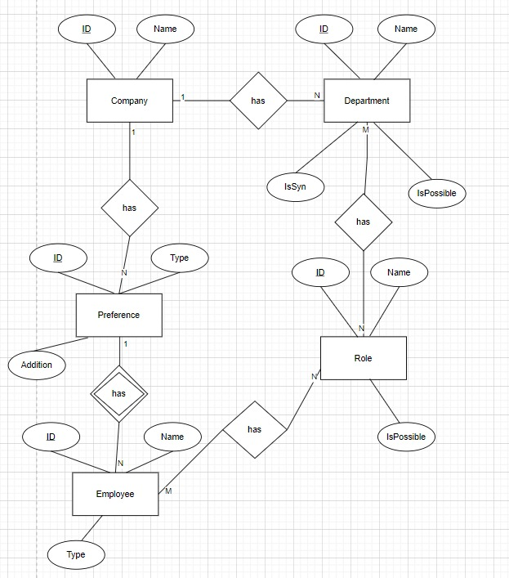
ERD

Slide 6
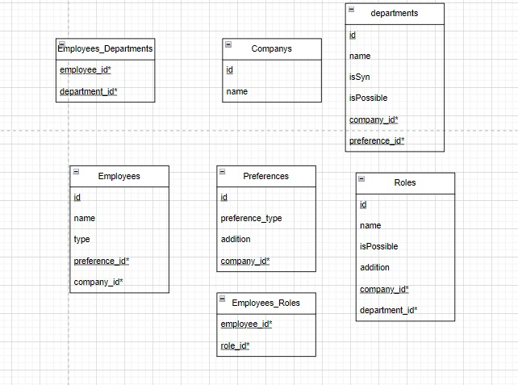
Tables

Slide 7
Thank you for listening

